Slide 1
Uncontrolled copy not subject to amendment
Map Reading
Learning Outcome 2
Be able to use the UK grid referencing system to find a location
Version 2.10 OCT 2014

Slide 2
Plotting a Grid Reference

Slide 3
The World
The earth is a sphere (oblate spheroid if you want to be precise!)
Rotates on its axis – North / South pole (called True North / True South)
A imaginary line runs around the middle dividing North “hemisphere” and South “Hemisphere” – called the Equator

Slide 4
The World
North Pole
Northern Hemisphere
Equator
Southern Hemisphere
South Pole

Slide 5
The World as a Map
If you cover the globe with imaginary lines to make a grid, it can help you find your position on the earth…
Firstly, add lines running parallel to the Equator, moving North and South to the Poles….
These are called Lines of Latitude
They run all the way round the earth

Slide 6
Lines of Latitude
90 degrees North (North Pole)
60 degrees North
30 degrees North
0 Degrees (Equator)
30 degrees South
60 degrees South
90 degrees South (South Pole)

Slide 7
Lines of Longitude
Also called “Meridians” and run from the North Pole to the South Pole
Start from 0 degrees, called the Prime Meridian, or Greenwich Meridian (as it runs through Greenwich!)
Run half way round the earth in a semi-circle
Shortest distance between 2 points on the Earth called “Great Circles”

Slide 8
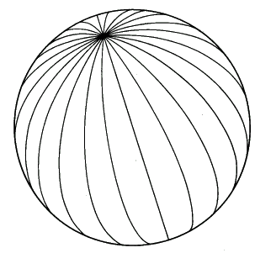
Lines of Longitude
North Pole
Prime Meridian – 0 degrees

Slide 9
Latitude and Longitude Measurement
Lines of latitude and longitude are numbered:
Latitude lines run from 0-90 degrees North and South of the Equator
Longitude lines run 0-180 degrees East and West of the Prime Meridian
Why…..?

Slide 10
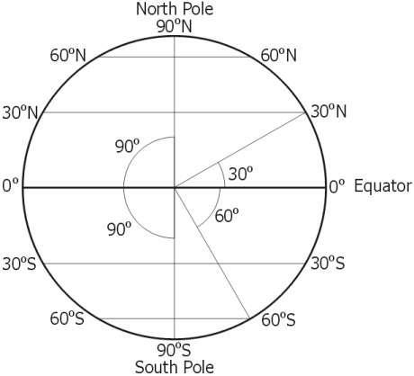
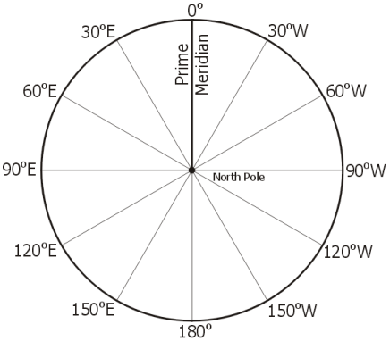
Latitude and Longitude Measurement
Latitude
Longitude

Slide 11
Latitude and Longitude Measurement

Slide 12
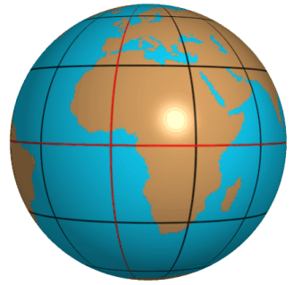
Latitude and Longitude Recording your Position
Equator and Prime Meridian highlighted in red
Point at which these lines meet is 0° Latitude, 0° Longitude

Slide 13
Latitude and Longitude Recording your Position
Lines in 30° intervals
What is the Lat / Long of the red dot? (don’t forget North / South / East / West!
Answer?

Slide 14
Latitude and Longitude Recording your Position
Lines in 30° intervals
What is the Lat / Long of the red dot? (don’t forget North / South / East / West!
Answer - 30°N 60°E

Slide 15
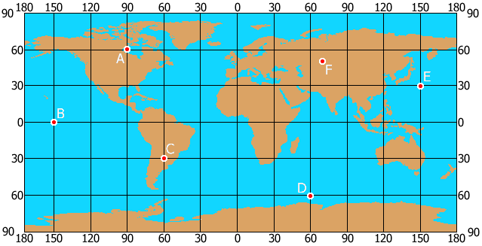
Quiz Give the Latitude and Longitude of the 6 red dots

Slide 16
Answers
A = 60N 90W
B = 0 150W
C = 30S 60W
D = 60S 60E
E = 30N 150E
F = 50N 70E

Slide 17
So what are Minutes then?
You know that circles are measured in Degrees
Degrees are split into Minutes - ‘
There are 60 minutes per degree
Minutes are split into…. Guess….
How many in a minute?
Marked as “

Slide 18
Some really complicated maths…
1 minute (1’) on the Equator equals 1 Nautical Mile
1 degree therefore equals 60’, or 60NM
360 degrees = 360 x 60’ = 21600’
21600 Nautical Miles – the circumference of the earth!

Slide 19
Latitude and Longitude
Marked along the black border around the map in degrees and minutes
Not drawn on the map – different grid on Ordnance Survey maps

Slide 20
North
Q. How many “Norths” are there and what are they called?
A. ?

Slide 21
North
Q. How many “Norths” are there and what are they called?
A. 3……
True North
Magnetic North
Grid North

Slide 22
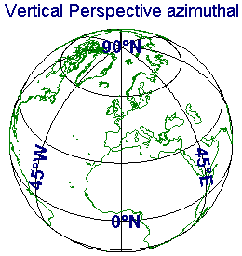
True North
The axis the earth rotates on

Slide 23
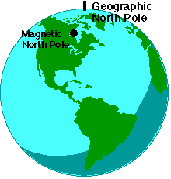
Magnetic North
Magnetic North is not aligned with the Earth’s axis
Magnetic North currently located over Hudson Bay, Canada
It is always moving

Slide 24
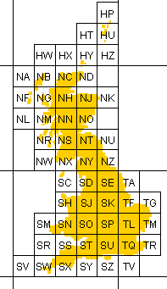
Grid North
An imaginary grid laid out over the UK
Called the National Grid (but not electricity!)
It is a flat projection of the UK (remember projections?)

Slide 25
Grid North
Each square on the grid represents 100km²

Slide 26
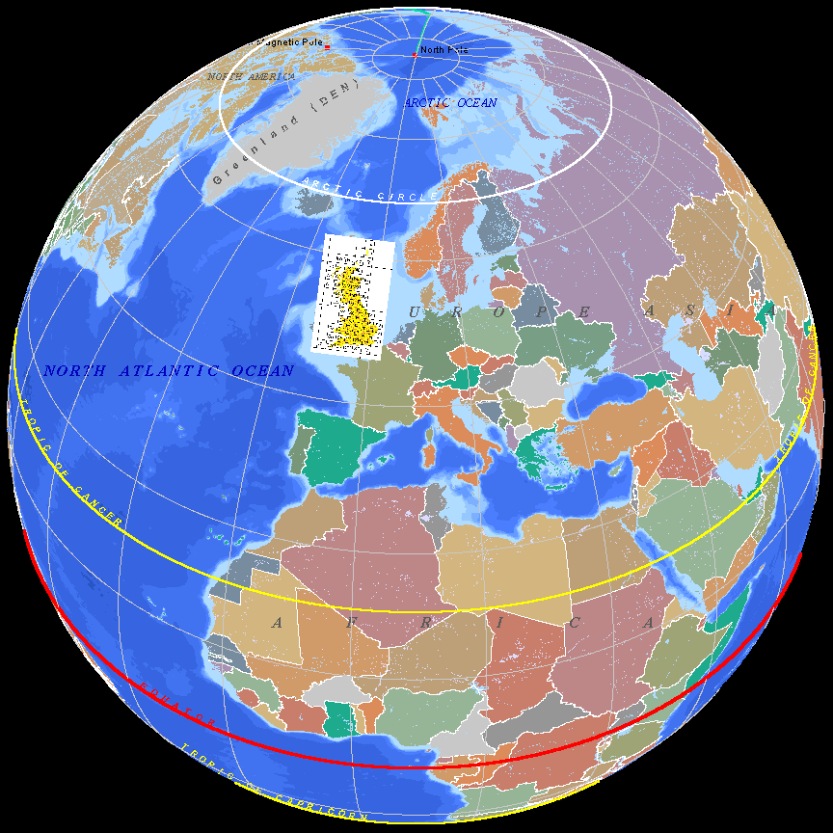
All Norths together

Slide 27
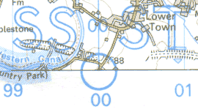
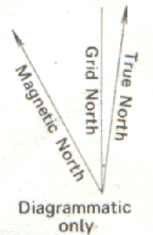
North
North positions indicated at the top of the map
Reference point at bottom of map
Diagram of Norths in Key

Slide 28
The Grid
Every OS map is covered in a matrix of blue bordered squares
These are known as Grid Lines
They go to make up the National Grid, the Ordnance Survey projection of the UK

Slide 29
National Grid
Every country has its own “National Grid”
UK’s grid has its “Origin” off Cornwall
UK is covered in a grid of 100kmx100km grid squares
Each square is represented by 2 letters

Slide 30
Grid lines
Every Ordnance Survey map is covered in a series of grids
By learning to use these grids we are able to locate a particular point on a map

Slide 31
Distance
Grid lines on all Ordnance Survey Maps are spaced 1km apart, regardless of scale
This makes it easy to judge the rough distance between points by counting squares
1.5 km
1 km

Slide 32
Grid Lines
Horizontal Lines = Northings
52
52
63
64
65
66
51
51
50
50
Vertical Lines = Eastings
49
62
63
64
65
66

Slide 33
Reading a Grid Reference
Grid references should be read in the following order:
Eastings - “Along the Corridor”
Northings - “Up the Stairs”

Slide 34
Plotting a Grid Square
52
52
63
64
65
66
51
51
Stairs
The
50
50
& Up
Along the Corridor
49
62
63
64
65
66

Slide 35
Plotting a Grid Square
52
52
63
64
65
66
51
51
Grid: 64 50
50
50
49
62
63
64
65
66

Slide 36
Accurate plotting
Having plotted the grid Square (1km x 1km) you will often need to establish the accurate location of a point or feature within the Square
This is achieved by dividing the square into a further ten Eastings (Vertical lines) & Northings (Horizontal lines)
These additional lines are read in exactly the same manner as before

Slide 37
Accurate Plotting (One Grid Square)
1 km
0
9
8
7
6
5
1 km
4
3
2
1
50
0
0
1
2
3
4
5
6
7
8
9
0
64

Slide 38
Plotting an accurate location 100 metre accuracy
62
63
64
65
66
52
Grid: 646 504
51
50
49

Slide 39
Now let us go through that again with different examples and a little test at the end

Slide 40
National Grid
SU
These squares are then subdivided into 10km x 10km squares
Numbered 0 to 9
Measured in Eastings then Northings
10km grid square SU63 is marked in red
9
8
7
6
5
4
3
2
1
0
Northings
0 1 2 3 4 5 6 7 8 9
Eastings

Slide 41
Grid References
Lets zoom in to one of those 10x10 grid squares – SU63…
The 2 letter code for the 100km grid is shown in each corner of the map, or on the key
Divided into 1km x 1km grid squares, numbered 0-9
40
39
38
37
36
35
34
33
32
31
30
SU
SU
SU
SU
60 61 62 63 64 65 66 67 68 69 70

Slide 42
4 figure Grid References
4 figure grid references show a whole 1km grid square…
Always start at the South West corner
What is the grid reference for the red square?
Answer…?
40
39
38
37
36
35
34
33
32
31
30
SU
SU
SU
SU
60 61 62 63 64 65 66 67 68 69 70

Slide 43
4 figure Grid References
4 figure grid references show a whole 1km grid square…
Always start at the South West corner
What is the grid reference for the red square?
Answer…SU6835
40
39
38
37
36
35
34
33
32
31
30
SU
SU
SU
SU
60 61 62 63 64 65 66 67 68 69 70

Slide 44
6 figure Grid References
6 figure grid references are used to give more accurate positions
Again divide each side of the 1km square into 10, and estimate
Give Eastings first, then Northings
An easy way of finding a Grid Reference is to use a “Roamer”
40
39
38
37
36
35
34
33
32
31
30
SU
SU
SU
SU
60 61 62 63 64 65 66 67 68 69 70

Slide 45
Grid References Exercise
What is the 4 figure Grid Reference (GR) of the red square?
What is the 6 figure Grid Reference of the red dot?
40
39
38
37
36
35
34
33
32
31
30
SU
SU
SU
SU
60 61 62 63 64 65 66 67 68 69 70

Slide 46
Grid References Exercise
What is the 4 figure Grid Reference (GR) of the red square?
Answer – SU6435
What is the 6 figure Grid Reference of the red dot?
Answer – SU624322
40
39
38
37
36
35
34
33
32
31
30
SU
SU
SU
SU
60 61 62 63 64 65 66 67 68 69 70

Slide 47
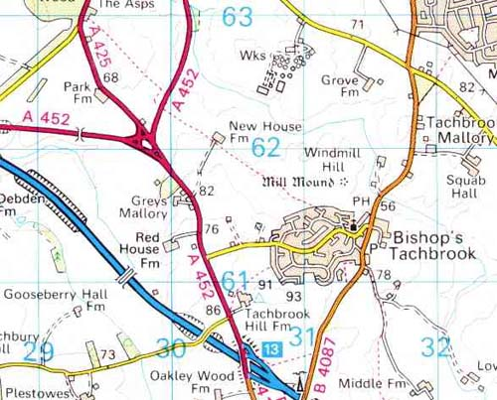
A real map….
What is in Grid Square 3161?
What is at position 308626?
What road runs between position 310600 and 318630?

Slide 48
Answers
Bishop’s Tachbrook
Water Works
B4087

Slide 49
A real map….
Give a 4-figure reference for Grove Farm
What is the 6 figure reference for the church in Bishop’s Tachbrook?
What is the 6 figure GR for the mast next to the motorway junction?

Slide 50
Answers
3162
314614
310602

Slide 51
Measuring Distance
By using the scale at the bottom of each Ordnance Survey Map you can easily convert a measurement in centimetres into a real distance on the ground.

Slide 52
Measuring Distance using a Silva Compass
Nearly all compasses have a centimetre scale which proves an effective tool for measuring the distance between two points.

Slide 53
Roamer

Slide 54
Roamer Scale

Slide 55
Measuring Distance using a Piece of String
Trace your route on the map with a piece of string and mark the points at which the route starts and finishes on the string
Place the string against the scale on the map and read off the equivalent distance on the ground

Slide 56
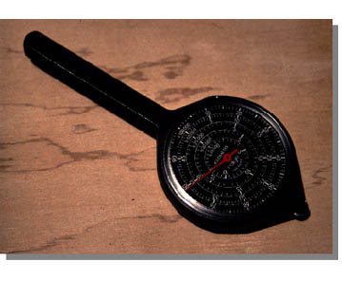
Measuring Distance using a Map Measurer
Map measurers are purposefully designed for measuring distances on a map
Trace your route with the small wheel at the bottom of the measurer and it will automatically tell you the distance on the ground via a rotating scale

